Slide 1
EMPLOYEE ATTRITION 2023
Power BI Visualization
Kaniskasri T S P
Praveen Raj T G
II B.Sc., CS ( Data Science & Analytics)

Slide 2
Introduction to Employee Attrition Analysis Using Power BI
Employee attrition is a critical challenge for organizations impacting productivity, workforce stability and operational costs.
Understanding why employee leave is essential for companies to develop effective retention strategies.
Our Projects leverages Power BI to analyze attrition trends using interactive dashboards and data analytics.

Slide 3
Datasets Overview
Our dataset, Employee Attrition Dataset, is used to analyze employee attrition trends and influencing factors.
It is sourced from Kaggle, a popular dataset platform.
This dataset helps in understanding why employees leave and identifying patterns.

Slide 4
key features
Employee Demographics: Age, Gender, Marital Status
Job releted Information: Department, job Role,Monthly Income, Years at company
Attrition Status: Indicates if an employee has left the company and still working on the company.
(Yes/ No): Yes indicated 1, No indicated 0

Slide 5
Why this dataset ?
Kaggle dataset is widely used in HR analytics and research.
Well-Structured data for easy preproccessing and visualizing in Power BI.
Enables predictive modeling and actionable insights.

Slide 6
Data Transformation
Removed Irrelevant features:
Excluded non-essential fields such as Employee ID, Overtime, Training Hours, Performance Rating, Distance from Home to focus on key attrition factors.
Data Cleaning:
Checked for missing values and handled them appropriately.
Ensured data consistency by standardizing formats and removing duplicate records.Ensured data consistency by standardizing formats and removing duplicate records.

Slide 7
Column Transformation:
Attrition Column: Converted Yes → 1, No → 0 for easier analysis.
Reformatted categorical variables for better Power BI visualization.
Data Preparation for Power BI:
Optimized data structure for efficient dashboard performance.
Created new calculated columns using DAX functions for deeper insights.

Slide 8
DAX Function: (Data Analysis Expresssion)
DAX (Data Analysis Expressions) is a formula language used in Power BI for creating calculated columns, measures, and tables to enhance data analysis.
It helps in performing custom aggregations, filtering data, and deriving insights from raw datasets.
Formula for using the DAX:
Employee Count by Department = COUNT('employee_attrition_dataset'[Department])

Slide 9
Explanation about the formula:
This function counts the number of employees in each department.
Helps visualize workforce distribution across different departments.
Useful for HR decision-making regarding staffing and attrition.

Slide 10
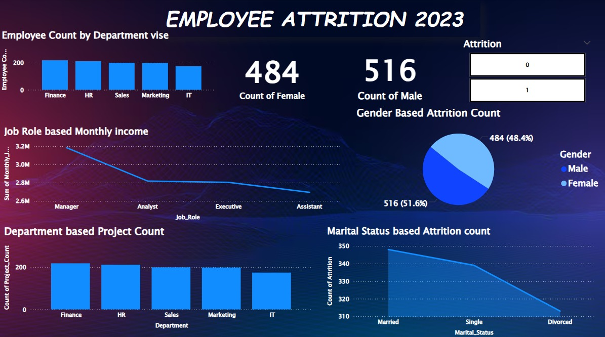
Employee Attrition 2023 Visualization:

Slide 11
Conclusion:
Employee attrition analysis helps organizations identify key factors affecting retention.
Power BI enables effective visualization of trends, making data-driven HR decisions easier.
Insights from this project can help reduce attrition, improve job satisfaction, and enhance employee retention strategies.
Future Scope: AI-based predictive models and real-time HR analytics can further improve workforce management.

Slide 12


